Slide 1
LECTURE ON
Examples based on Signed magnitude representation, signed 1's complement and signed 2's complement representation

Slide 2
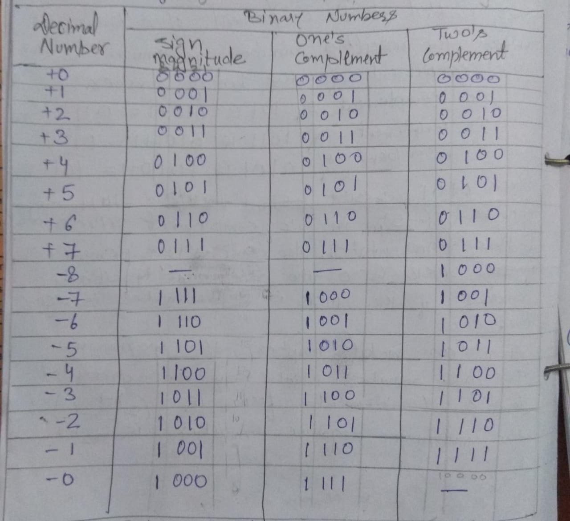
Sign magnitude,1’s complement & 2’s complement Representation using four bit

Slide 3
Example: Convert the sign magnitude binary number N=01100 a negative value having the same magnitude.
Answer: given that
N = 01100 is a signed magnitude number . Means first bit is a sign bit and remaining bit is magnitude. So here
sign bit = 0
magnitude = 1100
So a negative value having a same magnitude will be
for negative value sign bit = 1
magnitude = 1100
So the answer is 11100

Slide 4
Example: What decimal number does the signed magnitude binary number N=10011 represent?
Answer: given that
N = 10011 is a signed magnitude binary number . It Means first bit is a sign bit and remaining bit is magnitude. So here
sign bit = 1 means negative
magnitude = 0011 means 3
so the answer will be -3

Slide 5
Example: What decimal number does the unsigned binary number representation by the string of bits 11001.
Answer: given that
N = 11001 is a unsigned binary number . It means the whole number will represent the magnitude. So here
Magnitude = 11001
= 25
So the answer is 25

Slide 6
Example: Which bit of a signed binary number represent the sign?
Answer:
The leftmost bit

Slide 7
Example: Store +7 in an 8-bit memory location using sign & magnitude representation
Answer: First change the number to binary
7 = 111
total 8-bit memory location (N=8 Bit) to store +7.
one bit(left most bit) will store sign bit.
here for positive number +7
sign bit=0
The remaining (N-1=7) bits will store magnitude.
Magnitude=0000111 (add four zeros to make a total of 7 bits).
The result is 00000111 (store in memory location).

Slide 8
Example: Store -258 in 16 bit memory location using sign and magnitude representation.
Solution: First change the number to binary
258 = 100000010
total 16-bit memory location (N=16 Bit) to store -256.
one bit (left most bit) will store sign bit.
The remaining (N-1=15) bits will store magnitude.
Here for negative number(-258)
sign bit = 1
Magnitude=000000100000010 (add six zeros to make a total of 15 bits).
The result is 1000000100000010 (store in memory location

Slide 9
Example : Store -258 in a 16 bit memory location using 1's complement.
Solution: change to binary
258 = 100000010
signed magnitude representation
-258 = 1000000100000010
Now take 1’s complement of the magnitude part(000000100000010)
and the sign bit will be as it is
The result = 1111111011111101 this is 1’s complement representation of -258 in a 16 bit memory location.

Slide 10
Example: store +7 in 8 bit memory location using 1's complement representation.
Solution: change to binary
111
Signed magnitude representation
+7 = 00000111
The sign is +ve , so no more action is needed.
Result = 00000111 , this is 1's complement representation of +7.

Slide 11
Example: store +7 in 8 bit memory location using 2's complement representation.
Solution: change to binary
111
Signed magnitude representation of +7
+7 = 00000111
The sign is +ve , so no more action is needed.
Result = 00000111 , this is 2's complement representation of +7.

Slide 12
Example : Store -40 in a 16 bit memory location using 2's complement.
Solution: change to binary
40 = 101000
signed magnitude representation of -40 in 16 bit
-40 = 1000000000101000
Now take 2’s complement of the magnitude part (000000000101000)
and the sign bit will be as it is.
The result = 1111111111011000 this is 2’s complement representation of -40 in a 16 bit memory location.

Slide 13
Different types of representation for a binary number
BINARY | Unsigned | Sign and magnitude | 1’s complement | 2’s complement
1011 | 11 | -3 | -4 | -5
0101 | 5 | +5 | 5 | 5
10000000 | 128 | -0 | -127 | -128
1101 | 13 | -5 | -2 | -3
0110 | 6 | 6 | 6 | 6
11111110 | 254 | -126 | -1 | -2
01111110 | 126 | 126 | 126 | 126

